Slide 1
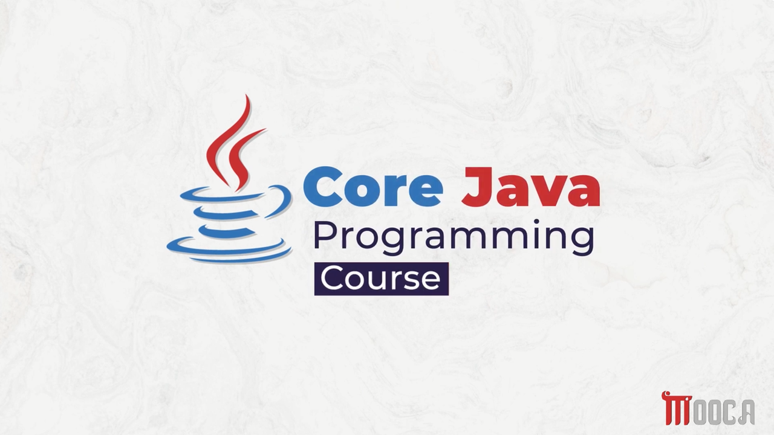

Slide 2
✍Lecture 3:
Primitive Data types .
Literals in java .
Variables .
Type Casting .
Arrays .
Lab 3.

Slide 3
✍Lecture 4 :
The Arithmetic and Bitwise Operators
The Relational and Boolean Logical Operators
The Ternary and instanceof Operators
Tha Arrow Operator and Lambda Expression
Selection Statements
Iteration Statements
Jump Statements
Java String
String Methods
StringBuffer, StringBuilder and StringTokenizer
Lab 4 .

Slide 4
✍Lecture 5 :
Java Packages
Import Packages
Interfaces
Implementing Interfaces
General Considerations
Functional Interfaces
Predefined Functional Interfaces
Lab 5 .

Slide 5
✍Lecture 6 :
Wrapper Classes
Annotations
Annotations Basics
Lab 6 .

Slide 6
✍Lecture 7 :
Exception
Exception Handlling
Lab 7 .

Slide 7
✍Lecture 8 :
Introduction to Generic Programming
Simple Generic Example Demo
Bounded Type Parameters
Wildcards
Lambda Expressions
Single Lambda Expressions
Block Lambda Expressions
Method Reference
Examples of Method Reference types

Slide 8
✍Why Generic Programming
Write reusable code
Work with different data types
Reduce code duplication
Provide type safety
Avoid unnecessary casting

Slide 9
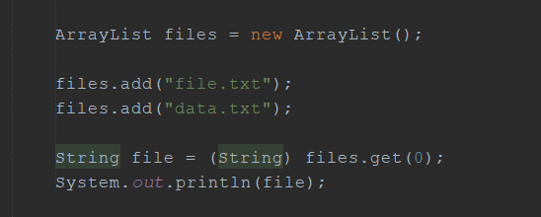




✍The Problem Before Generics
Problems:
Returns Object
Requires casting
No compile-time type checking

Slide 10






✍What is Generics
Generics allow us to define a class, interface, or method with a type parameter.
ArrayList → Generic class
String → Type argument
<String> → specifies the type

Slide 11
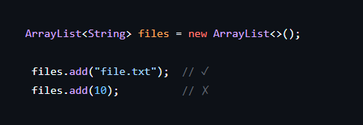



✍Advantages of Type Parameters
Type Safety

Slide 12
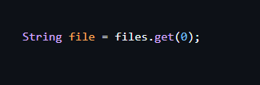






✍Advantages of Type Parameters
2. No Casting
3. Reusable Code
One class → different types

Slide 13
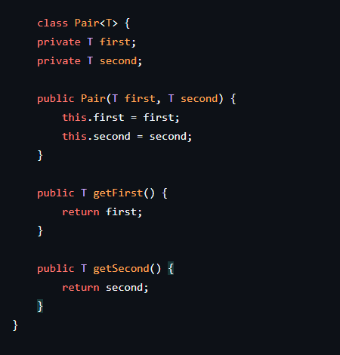

✍Generic Class

Slide 14
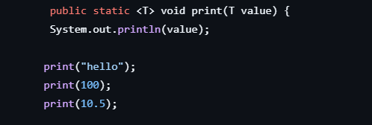




✍Generic Method

Slide 15
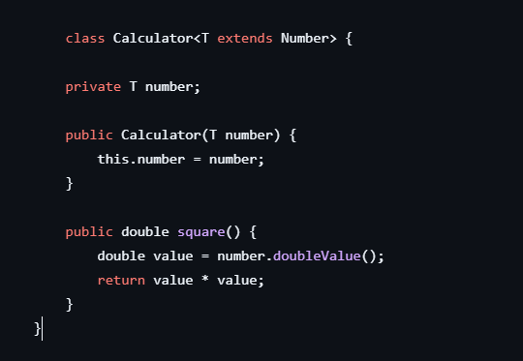

✍Type Parameter Bounds
Sometimes we want to restrict the allowed types.

Slide 16
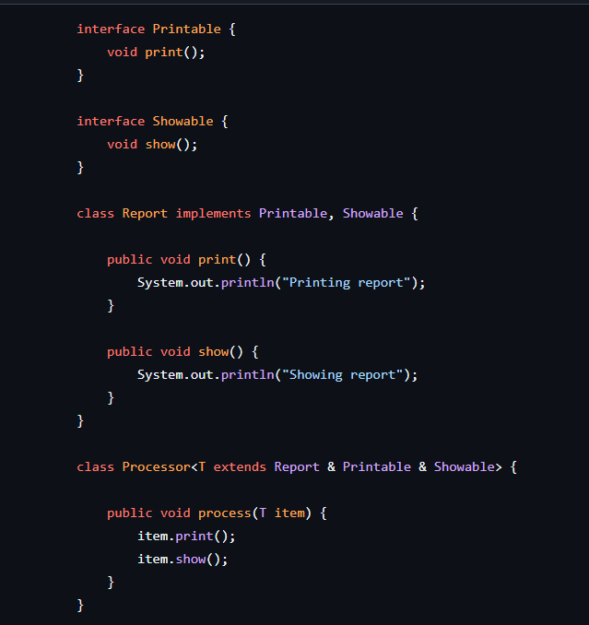

✍Multiple Bounds
A type parameter can have multiple bounds:

Slide 17
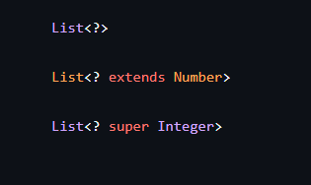






✍Wildcards
A wildcard is represented by ?
Types :

Slide 18
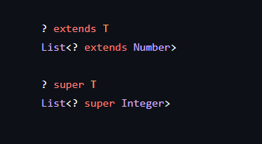




✍Upper & Lower Bounds
Upper Bound:
T or a subtype of T
Lower Bound:
T or a supertype of T

Slide 19





✍Summary
Generic Class
Generic Method
Bounds
Wildcards

Slide 20
✍Why Lambdas
Pass behavior as an argument
Reduce boilerplate code
Make code shorter and easier to read
Work with Functional Interfaces

Slide 21
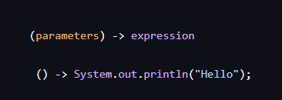

✍What is a Lambda Expression
A lambda expression is a block of code that can be passed around and executed later.

Slide 22
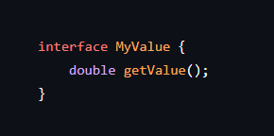
✍Functional Interface
An interface with exactly one abstract method.

Slide 23
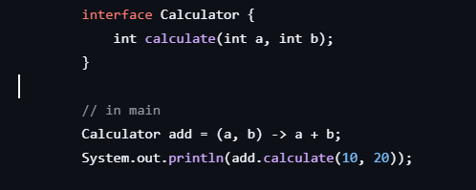





✍Lambda with Parameters

Slide 24
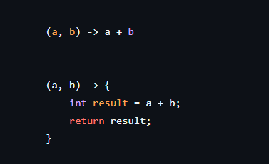

✍Lambda Expression Types
. Single-expression Lambda
. Block Lambda

Slide 25
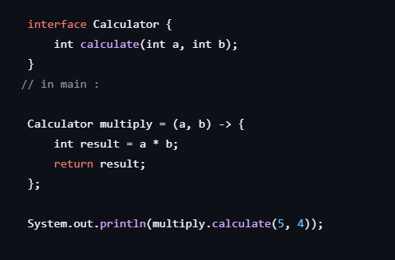





✍Block Lambda Example

Slide 26
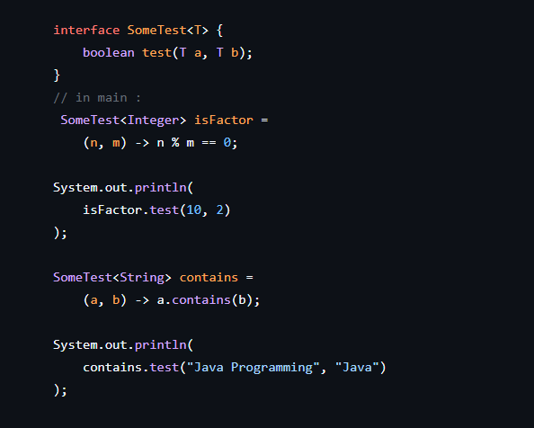
✍Generic Functional Interface

Slide 27

✍What are Method References
A method reference is a shorter way to write a lambda expression when an existing method can do the required operation.
Syntax :
ClassName::methodName
object::methodName

Slide 28




✍Types of Method References
Type | Syntax
Static method | ClassName::staticMethod
Constructor | ClassName::new
Instance method of arbitrary object | ClassName::instanceMethod
Instance method of a particular object | object::instanceMethod

Slide 29
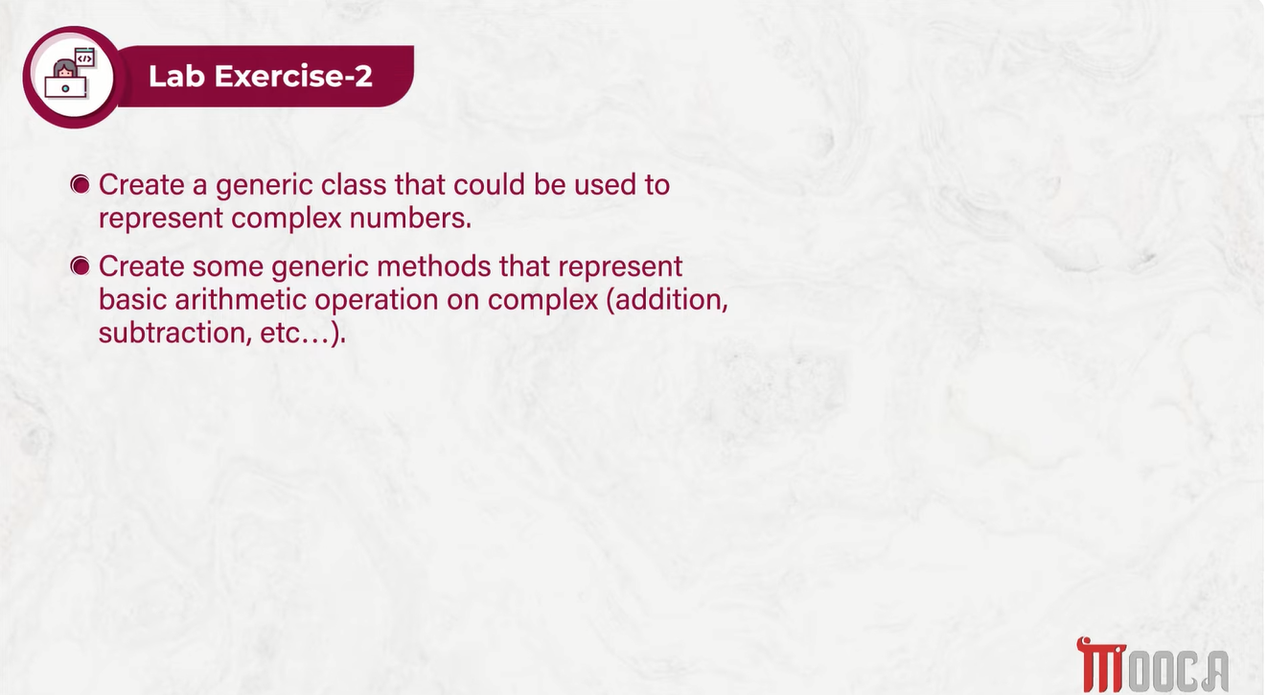

Slide 30
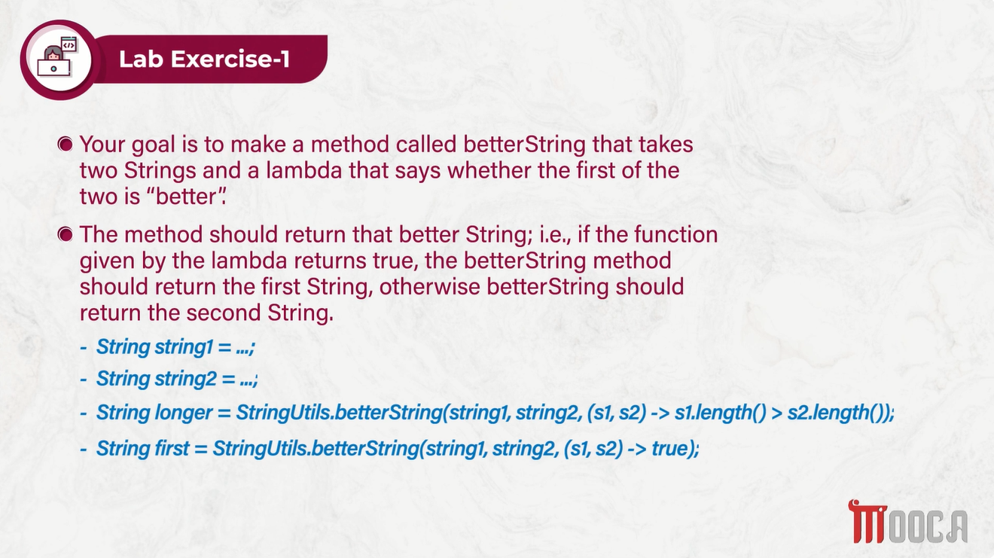

Slide 31
